Slide 1

Team Members Drashti M. Makwana : 216020307078 Yatri C. Chhatrala : 216020307079 Jenisa K. Vasani : 216020307080
Human Identification with
Face Recognition & Social Media Integration
Guide Name : D. S. Pathak
A.V. Parekh Technical Institute
Computer Engineering Department
(NBA Accredited)

Slide 2

INTRODUCTION
Different Uses Of Face Recognition
School Attendance System
Retail Crime
Security Identification
Identifying accounts on social media
Finding Missing Person
Recognizing Drivers in Cars
Face recognition is a step further to face detection. In face detection, we only detect the location of the human face in an image but in face recognition, we make a system that can identify humans.
Face recognition is a broad challenge of verifying or identifying people in pictures or videos.
Big tech giants are still working to make a faster and more accurate face recognition model.

Slide 3
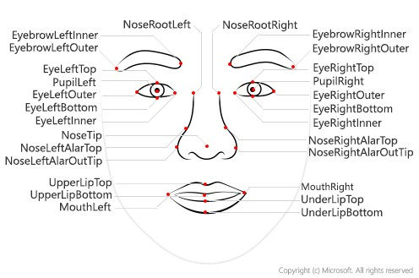
Deep Learning for Face Recognition:
Some of the widely used Deep Learning-based Face Recognition systems are as follows:
DeepFace
DeepID series of systems
VGGFace
FaceNet
Face recognizers generally take face images and find the important points such as the corner of the mouth, an eyebrow, eyes, nose, lips, etc. Coordinates of these points are called facial-features points, there are such 66 points.
In this way, a different technique for finding feature points give different results.

Slide 4
Working Mechanism Draw Flow Diagram
Whatsapp DP
Facebook ID --- > Camera Idenfication --> Home Camera (Speak) Name of the Person

Slide 5
Technology
Python Libraries
import cv2 - Camera Integration
import numpy as np
import face_recognition
Social Media API - Whatsapp + Facebook

Slide 6
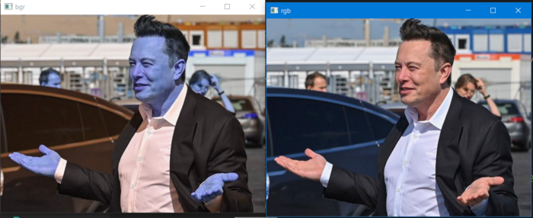
Steps for recognizing face
1) Loading Images
After importing libraries you need to load an image.
face_recognition library loads images in the form of BGR, in order to print the image you should convert it into RGB using OpenCV.
imgelon_bgr = face_recognition.load_image_file('elon.jpg')
imgelon_rgb = cv2.cvtColor(imgelon_bgr,cv2.COLOR_BGR2RGB)
cv2.imshow('bgr', imgelon_bgr)
cv2.imshow('rgb', imgelon_rgb)
cv2.waitKey(0)
As you see RGB looks natural so you will always change the channel to RGB.

Slide 7
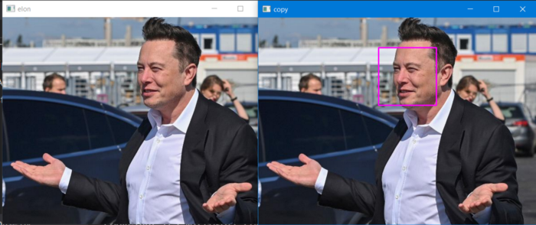
2) Find Face Location and Draw Bounding Boxes
You need to draw a bounding box around the faces in order to show if the human face has been detected or not.
imgelon =face_recognition.load_image_file('elon.jpg')
imgelon = cv2.cvtColor(imgelon,cv2.COLOR_BGR2RGB)
#----------Finding face Location for drawing bounding boxes-------
face = face_recognition.face_locations(imgelon_rgb)[0]
copy = imgelon.copy()
#-------------------Drawing the Rectangle-------------------------
cv2.rectangle(copy, (face[3], face[0]),(face[1], face[2]), (255,0,255), 2)
cv2.imshow('copy', copy)
cv2.imshow('elon',imgelon)
cv2.waitKey(0)

Slide 8

3) Training
At this stage, we convert the train image into some encodings and store the encodings with the given name of the person for that image.
train_elon_encodings = face_recognition.face_encodings(imgelon)[0]

Slide 9

4) Testing
For testing, we load an image and convert it into encodings, and now match encodings with the stored encodings during training, this matching is based on finding maximum similarity. When you find the encoding matching to the test image you get the name associated with train encodings.
face_recognition.compare_faces returns True if the person in both images are the same other it returns False.
# lets test an image
test = face_recognition.load_image_file('elon_2.jpg')
test = cv2.cvtColor(test, cv2.COLOR_BGR2RGB)
test_encode = face_recognition.face_encodings(test)[0]
print(face_recognition.compare_faces([train_encode],test_encode))

Slide 10
Challenges faced by Face Recognition Systems
Although building facial recognition seems easy it is not as easy in the real world images that are being taken without any constraint. There are several challenges that are faced by the Facial Recognitions System are as follows:
Illumination: It changes the face appearance drastically, it is observed that the slight changes in lighting conditions cause a significant impact on its results.
Pose: Facial Recognition systems are highly sensitive to the pose, Which may result in faulty recognition or no recognition if the database is only trained on frontal face view.
Facial Expressions: Different expressions of the same individual are another significant factor that needs to be taken into account. Modern Recognizers can easily deal with it though.
Low Resolution: Training of recognizer must be done on a good resolution picture, otherwise the model will fail to extract features.
Aging: With increasing age, the human face features shape, lines, texture changes which are yet another challenge.

Slide 11
TARGET AUDIENCE

Slide 12
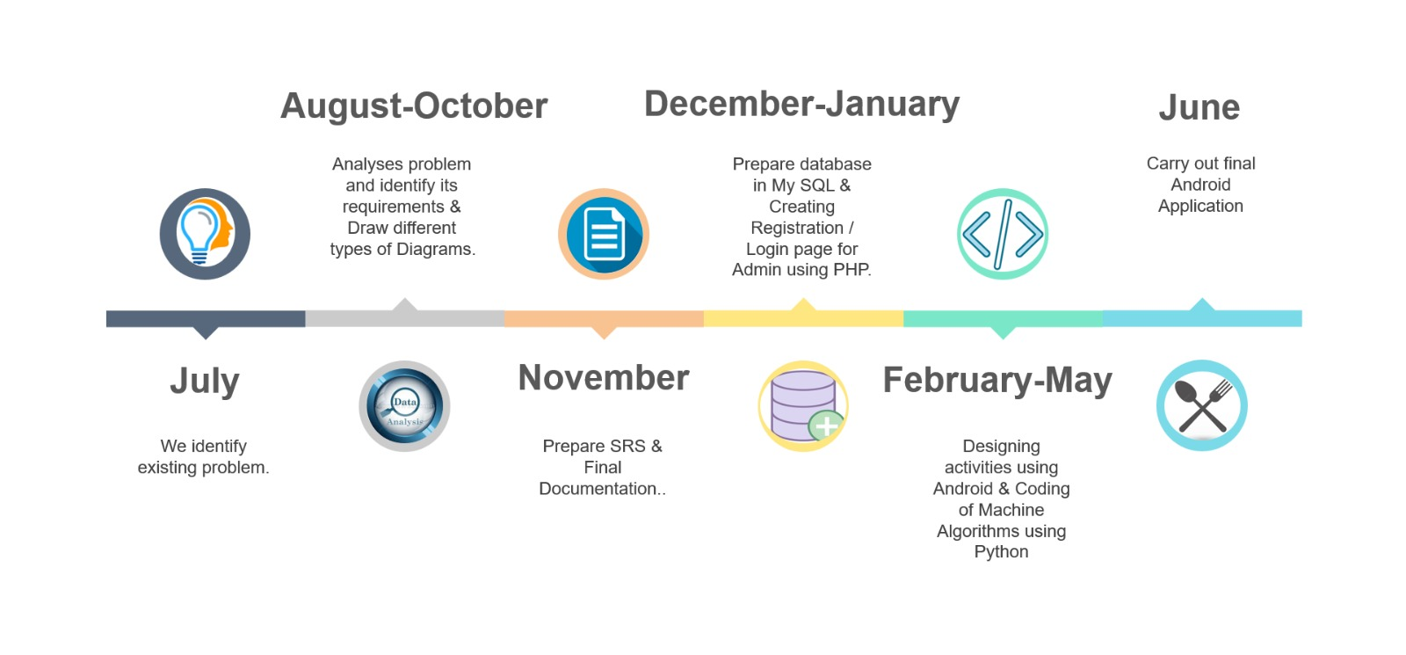
TIMELINE

Slide 13
FUND REQUIREMENT
$25
Camera Price
50%
$25
20%
Application Hosting

Slide 14
FUTURE SCOPE
Introduction to Cloud Kitchen.
Image Processing for any food items.
Employment .
Application will be available in multi-linguistic.

Slide 15
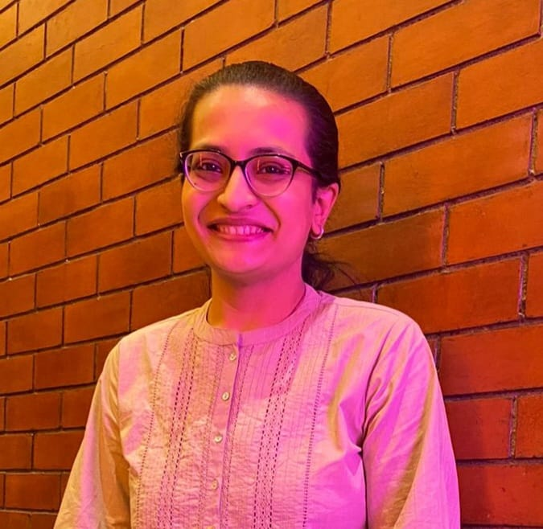



Our Team
GUIDE
TEAM MEMBERS
DARSHITA PATHAK
YATRI C. CHHATRALA
DRASHTI M. MAKWANA
JENISA K. VASANI
(Python Coding,
Java Coding)
(Python Coding)
(Python Coding,
Html, Css )

Slide 16

Thank You

